Slide 1
Advanced Programming
Karyar 2023
Sina Piri

Slide 2
Objects in the real world
When we describe an object in the real world, we do it by its attributes.
“Hi dad, I saw a CAT”.
We don’t need to say the attribute of the animal we saw to our dad!
By the way what is an animal?
Some object are also capable of performing actions.

Slide 3
Object oriented
OOP(Object Oriented Programming)?
It’s a programming paradigm based on the concept of objects, which contain data and code:
Data in the form of attributes.
Code in the form of Methods.
Not the only paradigm in programming!
The new concepts in OOP are Class and Object.

Slide 4
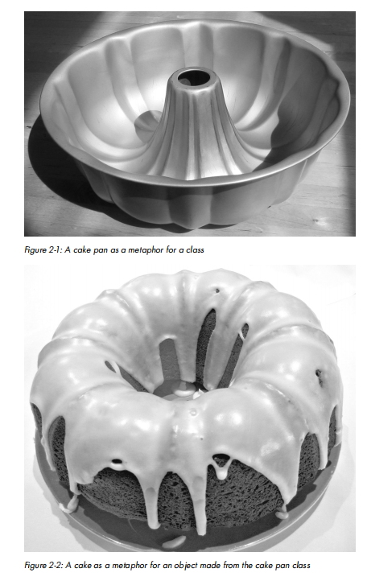
Class and Object
Class : Code that defines what an object will remember (its data or state) and the things that it will be able to do(its functions or behavior).
Example Class:
A Cake pan.
Blueprint of a house.
Object: Data, plus code that acts on that data over time

Slide 5
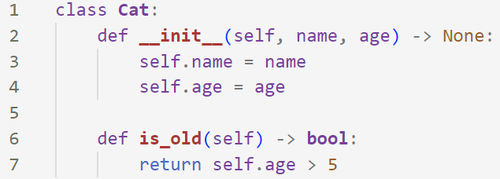
Class and Object
An example of defining a class in python.
If you run this code nothing happens! Its just a definition like a function definition.

Slide 6

Class and Object
Instantiation : The process of creating an object from a class.
Method : A function defined inside a class.
__init__ : A special method a class.
When you create an object from a class, this method runs automatically.
Not strictly required but try to write it even if you don’t need it!

Slide 7
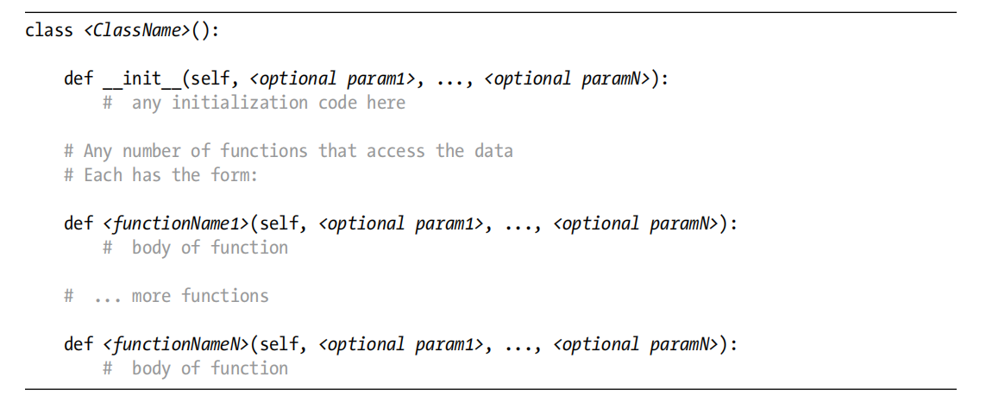
Class and Object

Slide 8
Scope and Instance variables
In procedural programming, there are two levels of scope:
Global scope: variables created in the main code and are available anywhere
Local scope: variables created inside a function and live as long as the function runs.
In OOP there is a third scope called object scope or class scope.

Slide 9
Scope and Instance variables
Class scope: The scope consisting of all the code inside the class definition.
Methods can have both local variables and instance varibales.
Local variable: In a method or a function, any variable whose name does not begin with self and is not in the global scope.
It will go away when that methods exist, meaning other methods or function can’t use it.
Instance variable: In a method, any variable whose name begins, by convention, with the prefix self. Instance variables have class or object scope.

Slide 10
Scope and Instance variables
Instance variables are created when they are first given a value(like global and local variables).
Usually they should be initialized in the __init__ but they can be initialized in other methods.
Each object created from a class gets its own set of instance variables, independent of any other objects!

Slide 11
Methods vs functions
All methods of a class must be indented under the class statement.
All methods have a special first parameter named self (by convention).
Methods in a class can use instance variables, written in the form of self.<variableName>.

Slide 12
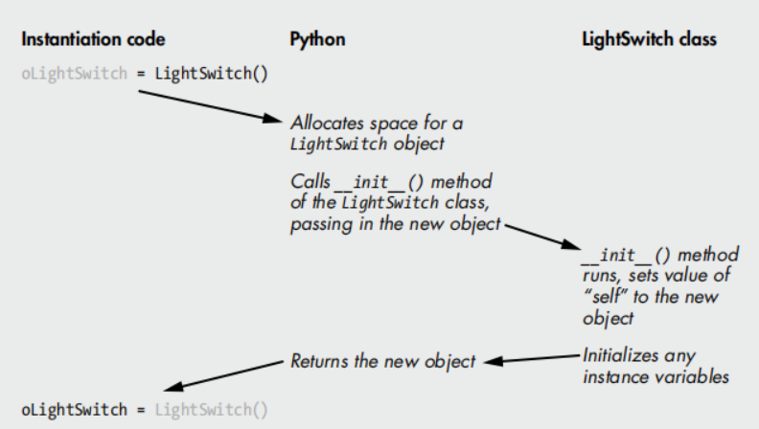
The instantiation process

Slide 13

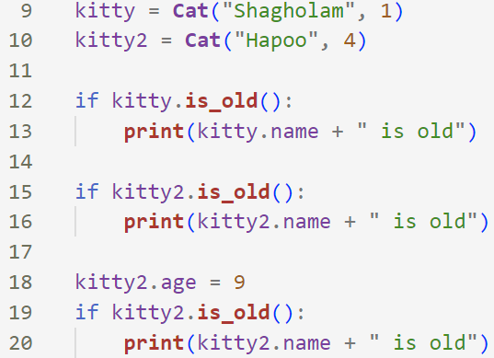
Calling Methods of an object
After creating an object from a class, you can call a method of an object:
You can also create multiple objects from a class.

Slide 14

Python Data types
All built-in data types in Python are implemented as classes.
All lists are instances of the list class.
They have methods like append(), count(), etc.

Slide 15
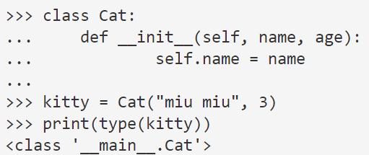
Python Data types
When you write a class you are defining a new data type.
After creating an instance of your class, you can use the type function to see the type of your object.

Slide 16
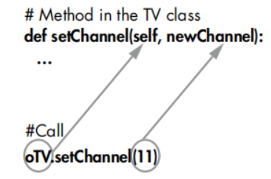
Passing arguments to a method
When calling a function, the number of arguments must match the number of parameters in the definition.
The same apply for methods, except one less. We don’t specify the self.

Slide 17
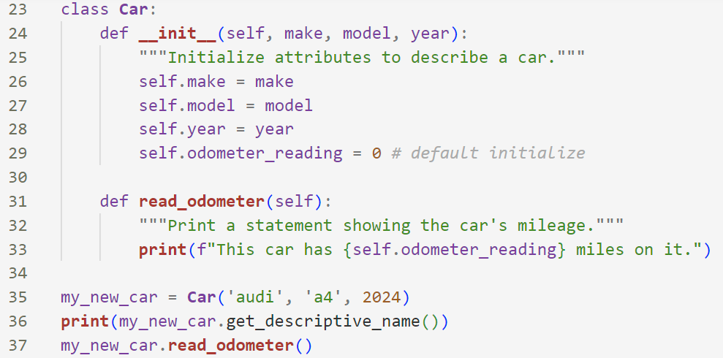
Setting a default value for an attribute
When an instance is created, attributes can be defined without being passed in as parameters.
These attributes can be defined in the __init__() method where they are assigned a default value.

Slide 18
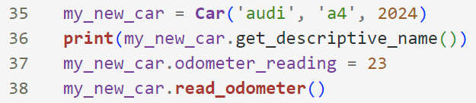
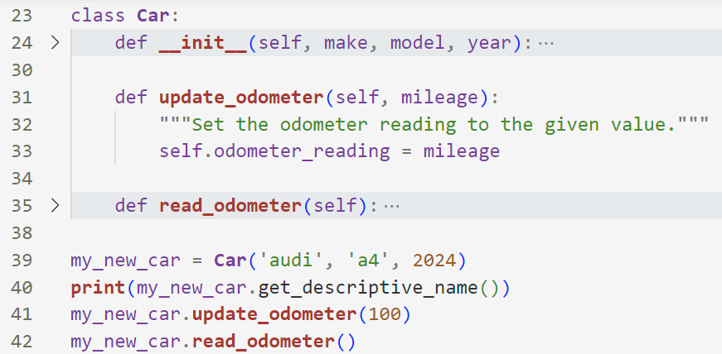
Modifying an attribute directly or through a method
You can modify an attribute directly:
Or through a method.

Slide 19
References
Object Oriented Python by Irv Kalb.
Python Crash Course by Eric Matthes.

